Slide 1
Data Science Engineer Assignment
Understanding the Data

Slide 2
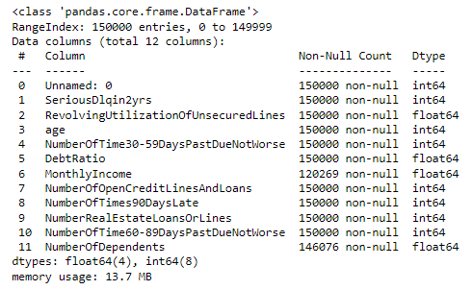
Exploratory Data Analysis
The dataset is made of 12 columns
4 float values and 8 integer
The MonthlyIncome and NumberofDependents columns contain null values
Null values should be converted to default value 0 in order to be parsable through and sql query
The “Unnamed: 0” column by default is blank and it represents the observations index
There are three columns representing three stages of past due days payments (30-59, 60-89, 90+)

Slide 3
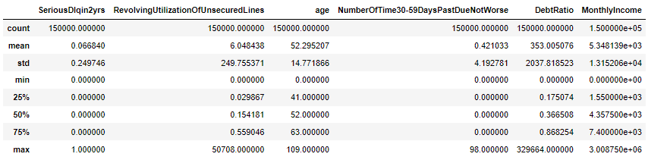
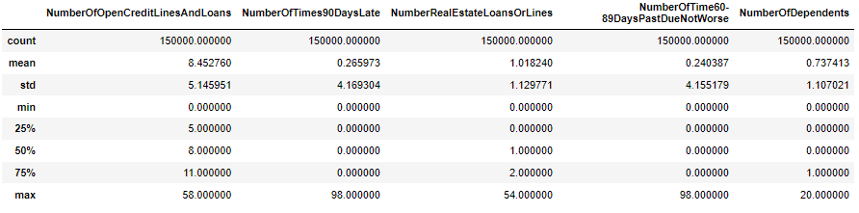
Exploratory Data Analysis
The applicant average age is 52
There are instances of applicants aged 0, most likely errors
The largest variability of value is in theRevolvingUtilizationOfUnsecuredLines and DebtRatio columns

Slide 4
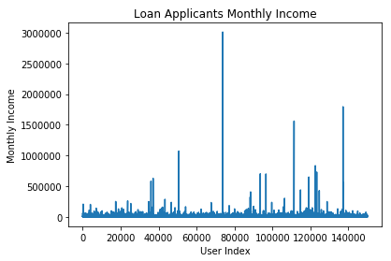
Exploratory Data Analysis
The vast majority of applicants have an income of less than 500,000$
There is only 12 instances of applicants with an income above that

Slide 5
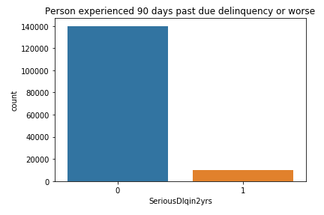

Exploratory Data Analysis
Less than 10% of applicants experienced 90 days past due to delinquency

Slide 6
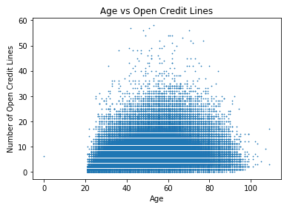
Exploratory Data Analysis
When comparing age with open credit lines it appears that the plateau is reached around the retirement age possibly suggesting the conclusion of mortgages for first homes

Slide 7
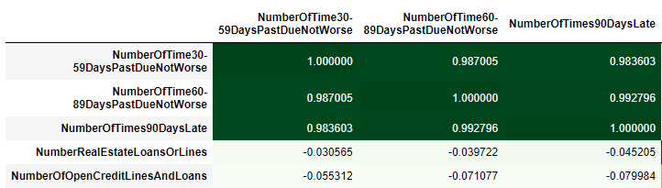
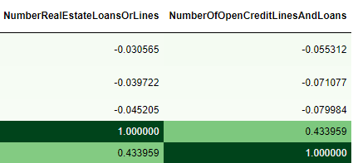
Exploratory Data Analysis
When looking at the correlation between variables the highest scores are among the number of days past due instances and between the number of loans and open credit lines
This can be explained with the nature of dependency between the variables e.g. an estate loan is also a open credit line, being 90 days past due also implies already being 60 and 30 days late

Slide 8




Data Ingestion Architecture
The sample data is processed through python in order to adjust irregularities such as missing values and create the initial table with the columns
A cleaned copy is the created in a different folder
A pgAgent job from postgresql DBMS on a daily basis fetches the file from
raw_data/sample_data.csv
processed_data/sample_data_processed.csv

